Slide 1
CSCI 331 - Project 2
Group 10 E
Edwin Ramos, Jay Mistry, Bing Gao, Michael Chang, Carlos Salinas, Akashdeep Singh, Diyor Zoirov

Slide 2

Akash’s Stored Procedures
Load_Data
AddForeignKeysToStarSchemaData
DropForeignKeysFromStarSchemaData

Slide 3
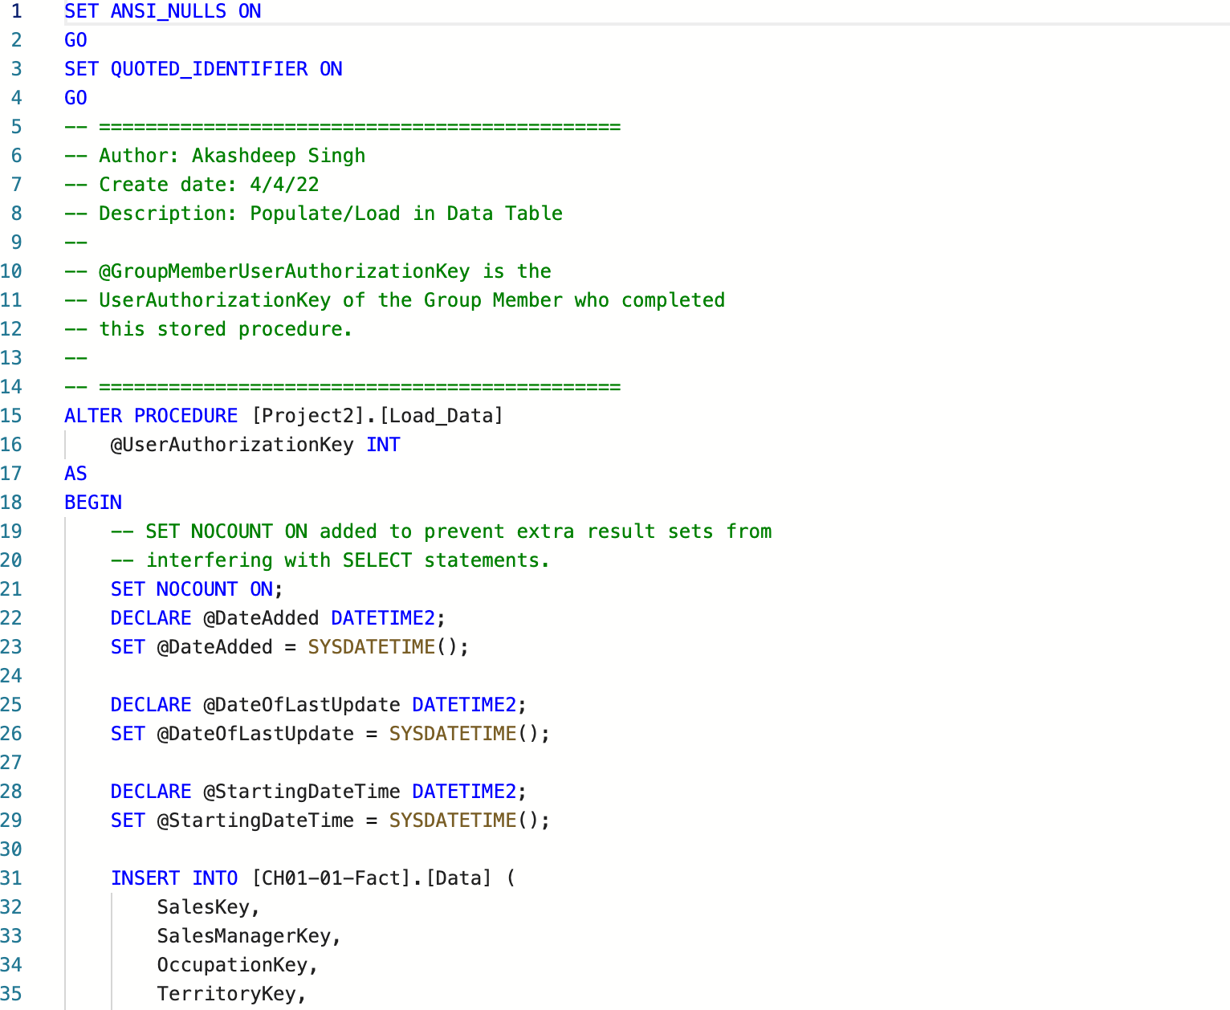
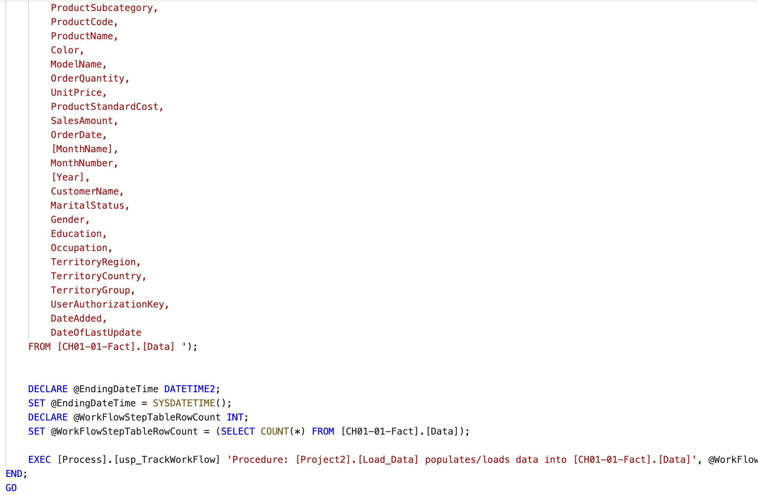
Load_Data
Used to load in Data from tables in our BIClass database.
Populates our data table using joins to concatenate and represent all our data to display
Variables for time are used to track our workflow steps
A view for the table is created for everything we inserted into our information to display

Slide 4
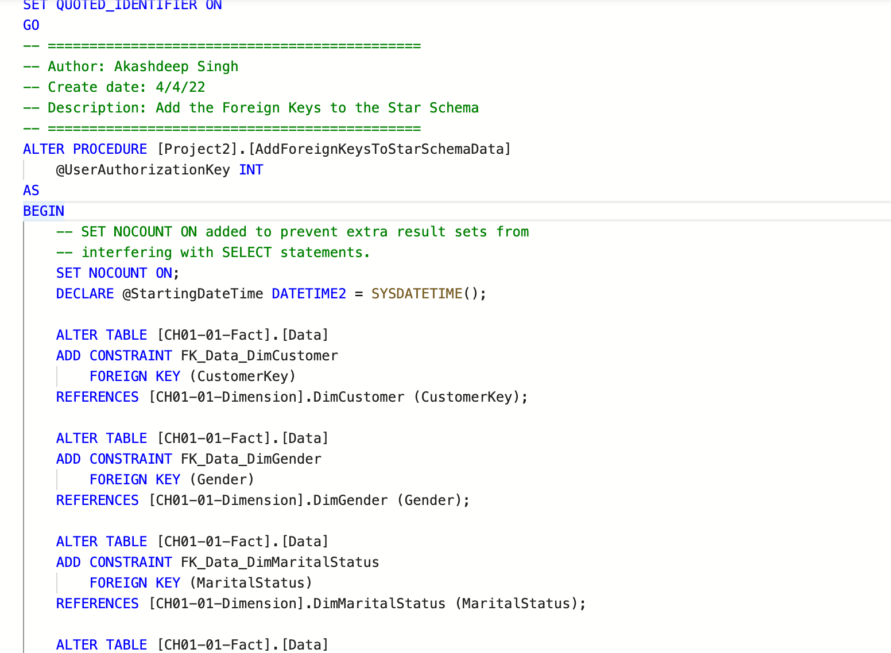
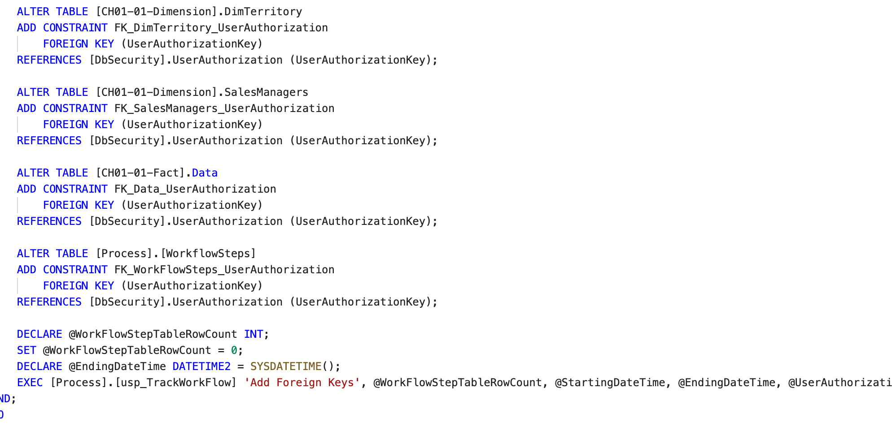
AddForeignKeysToStarSchemaData
Declare foreign keys for tables that exist in our Star Schema database
Using the data table we populated in the Load_Data procedure, foreign keys are set
At the end of each Alter block, we define which column and table is used for the foreign key relationship
Workflow steps are put into use by executing our TrackWorkFlow process which will track the time to run the procedure in ms

Slide 5
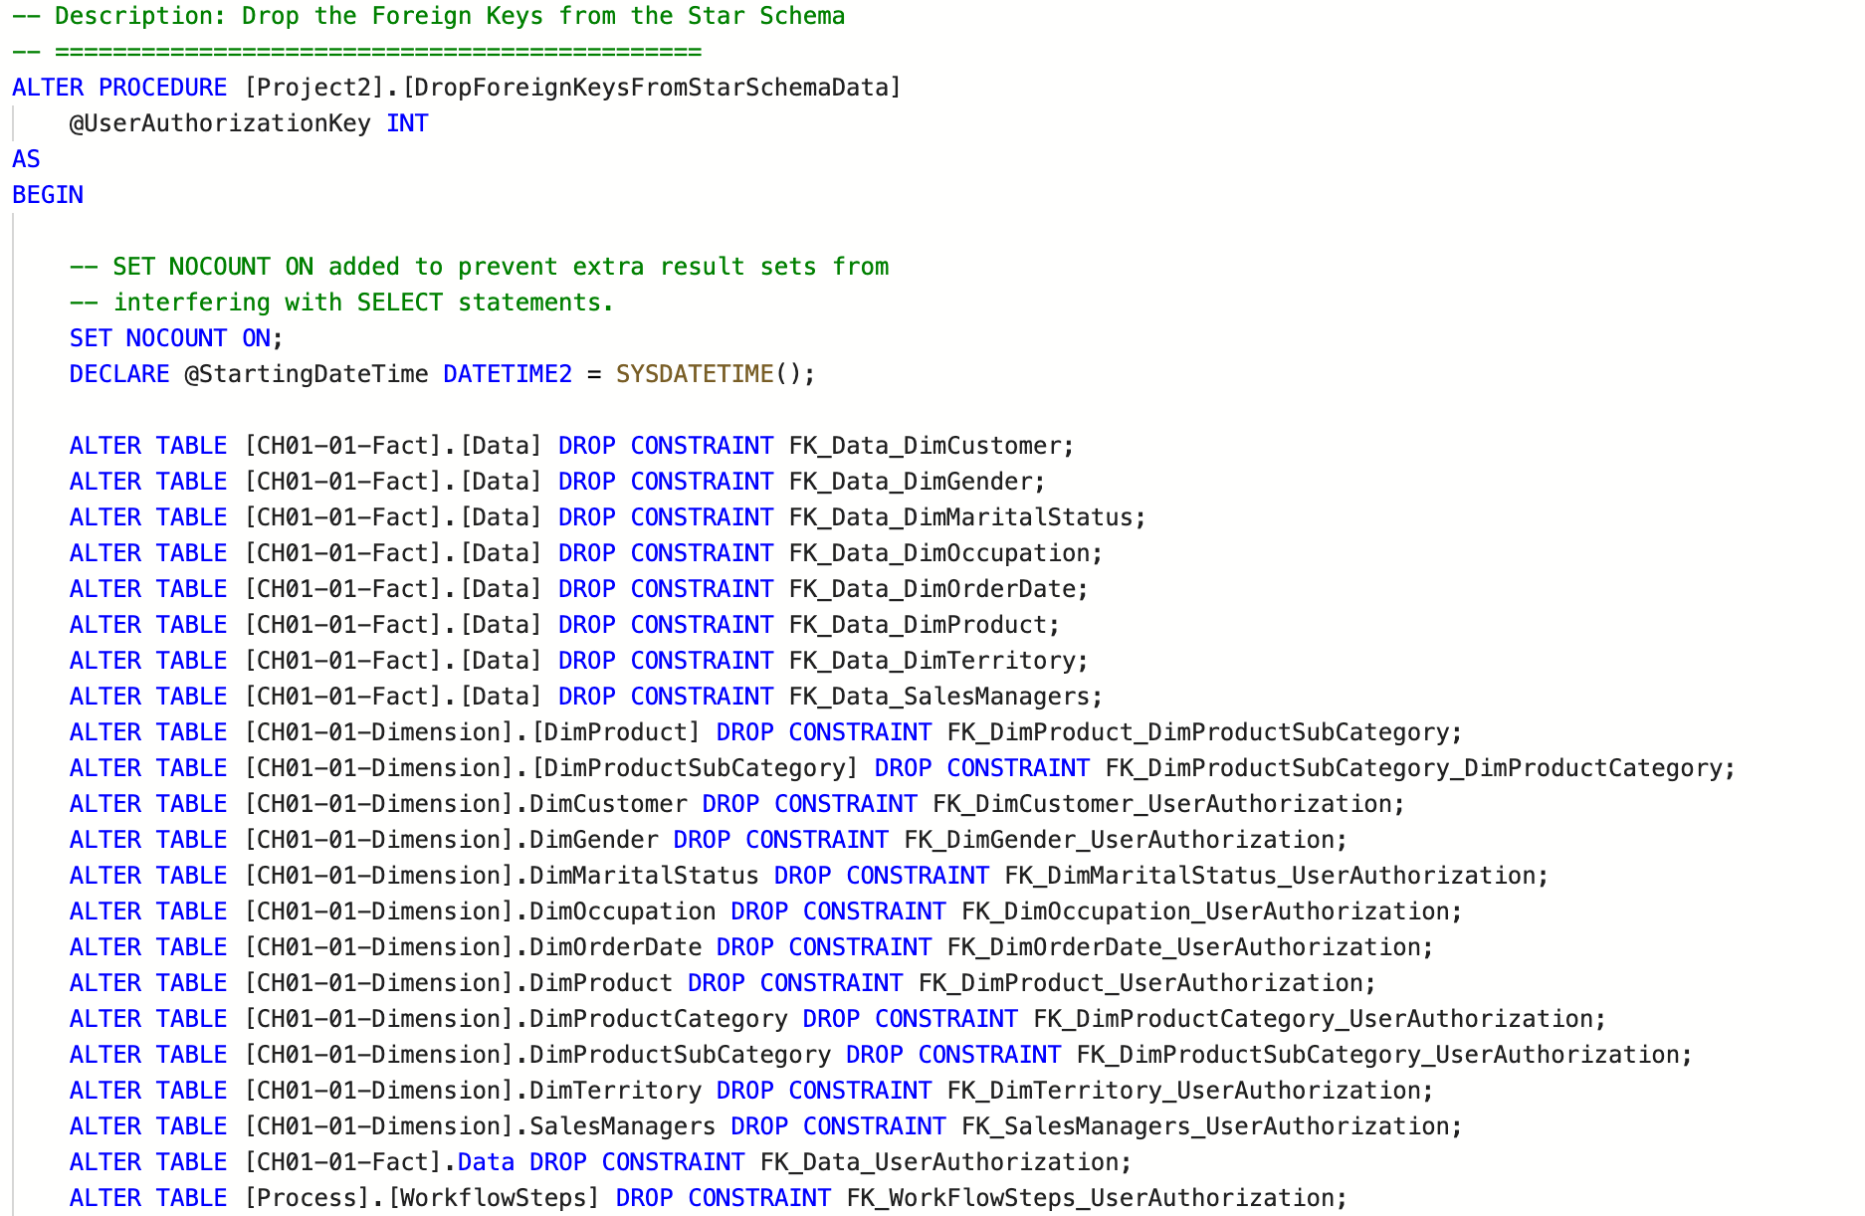
DropForeignKeysToStarSchemaTable
Altering the Data table we populated from Data_Load and the other tables in our Star Schema database by deleting the foreign keys we set using our AddForignKeysToStarSchema procedure
Once again, our workflow steps are put into use by executing our TrackWorkFlow process right before we end procedure

Slide 6
Michael’s Stored Procedures
Load_DimCustomer
Load_DimGender
Load_DimTerritory

Slide 7
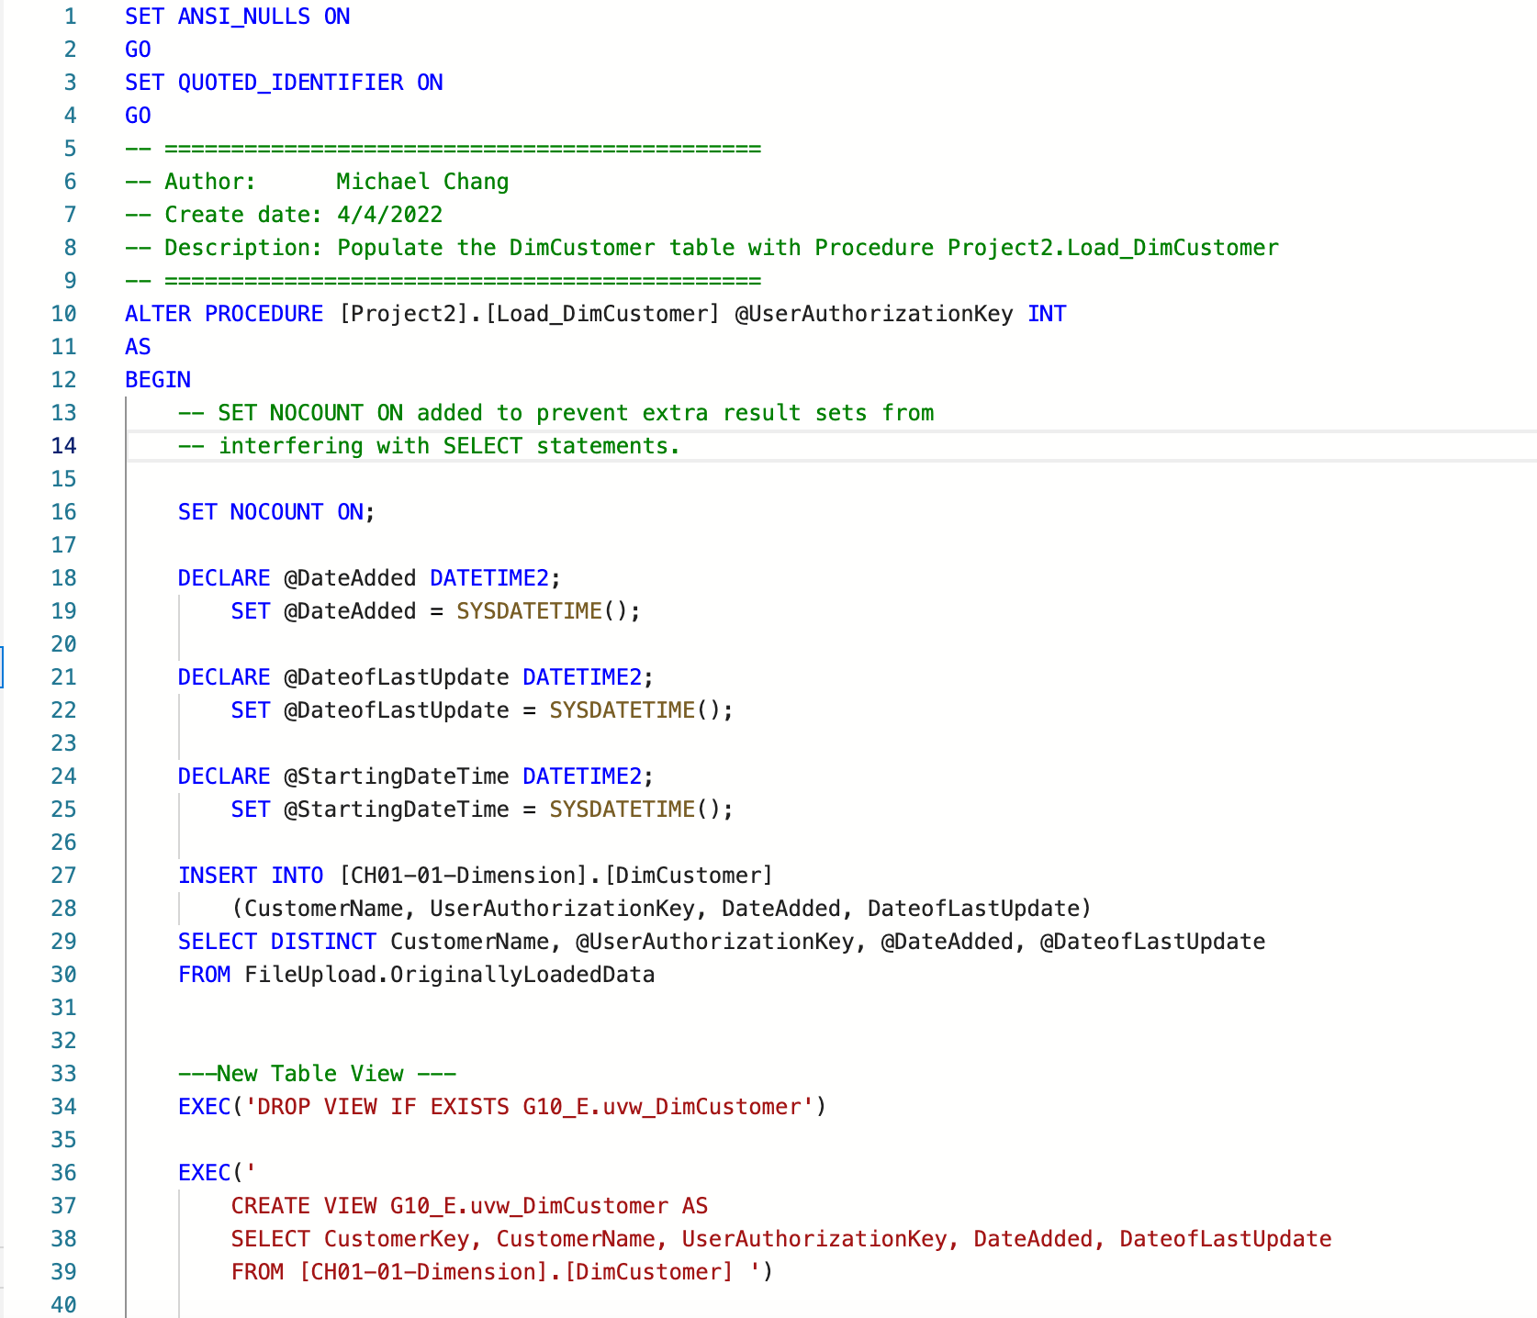
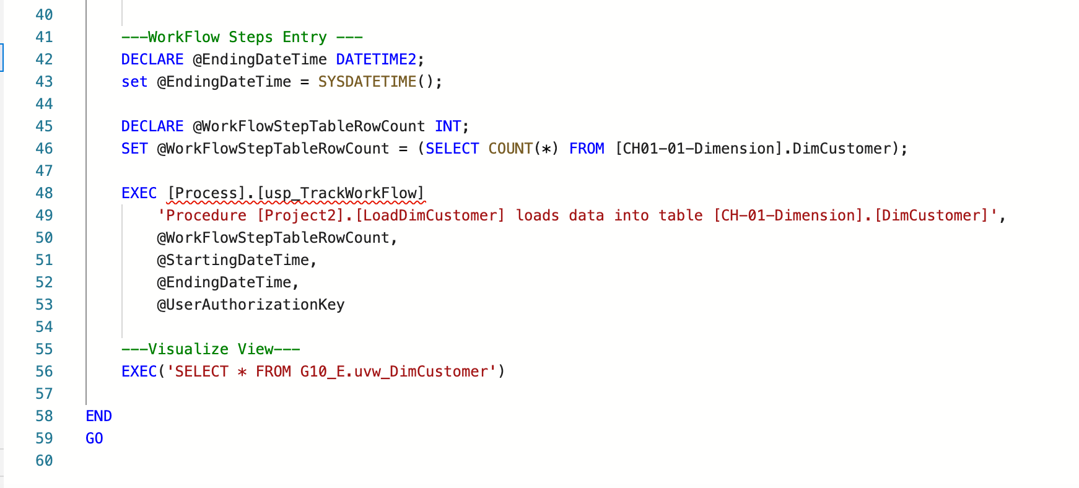
Load_DimCustomer
Populates the DimCustomer table with Procedure Project2.Load_DimCustomer
Then it creates a view, and logs the procedure in workflowsteps
Loads the customer info into [CH1-01-Dimension] from [FileUpload].[OriginallyLoaded Data]

Slide 8
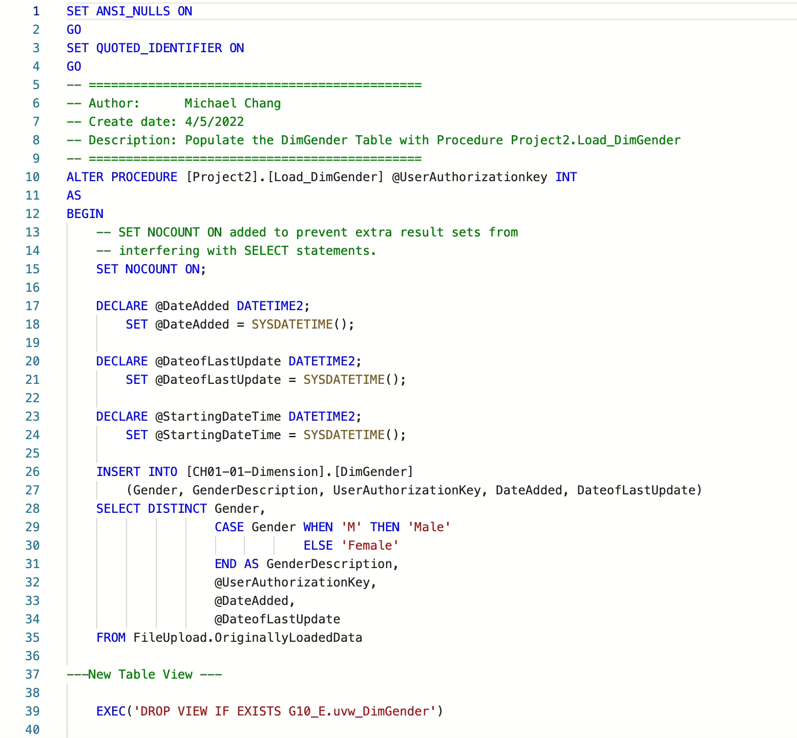
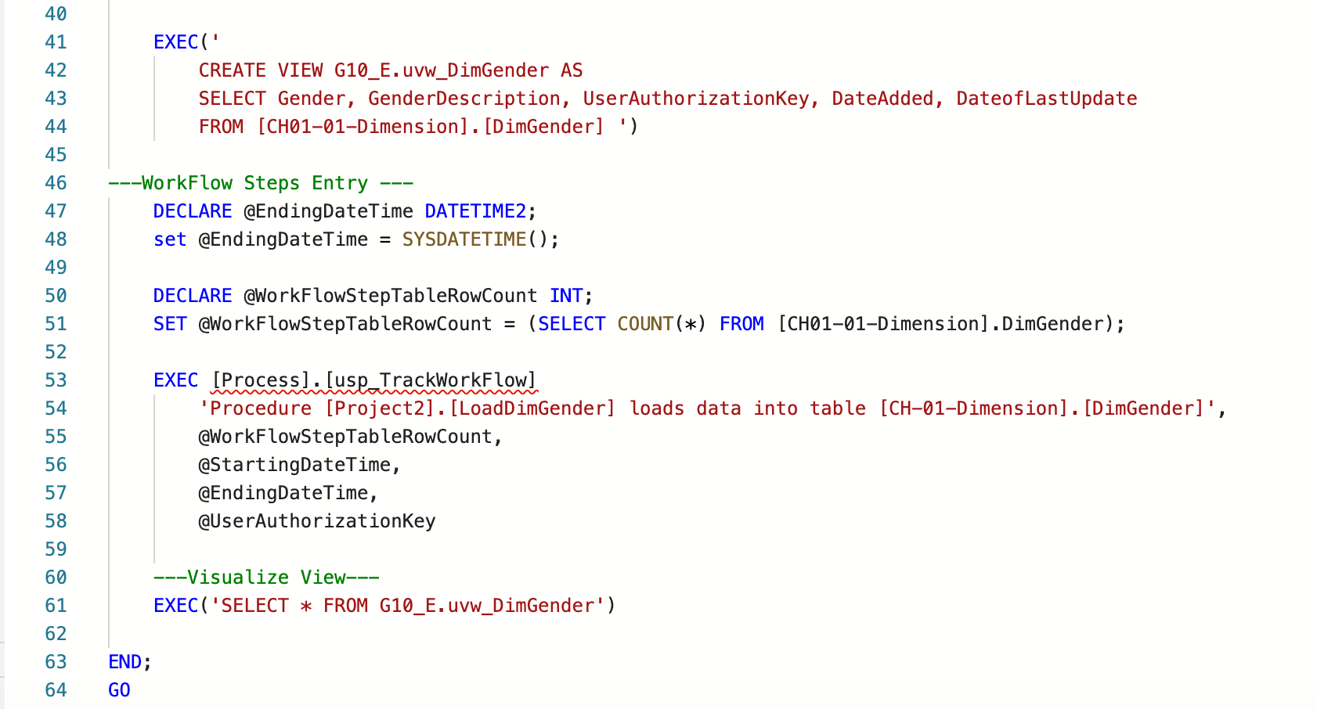
Load_DimGender
Populates the DimGender Table
Inserts data into [CH01-01-Dimension].[DimGender]
Records whether “Female” or “Male”

Slide 9
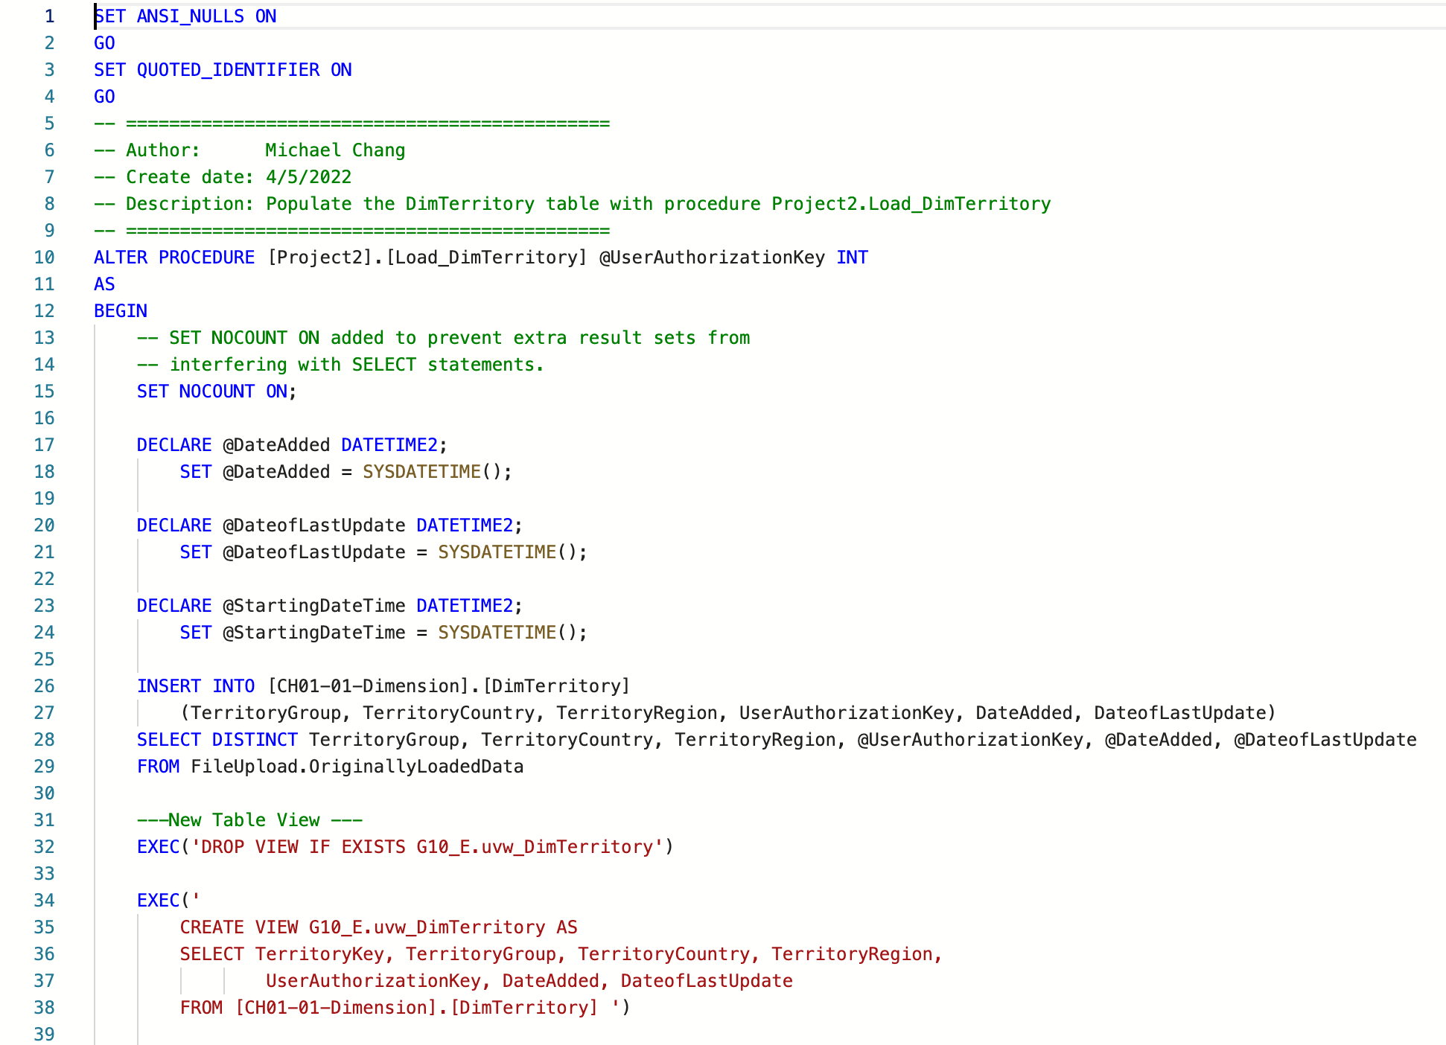
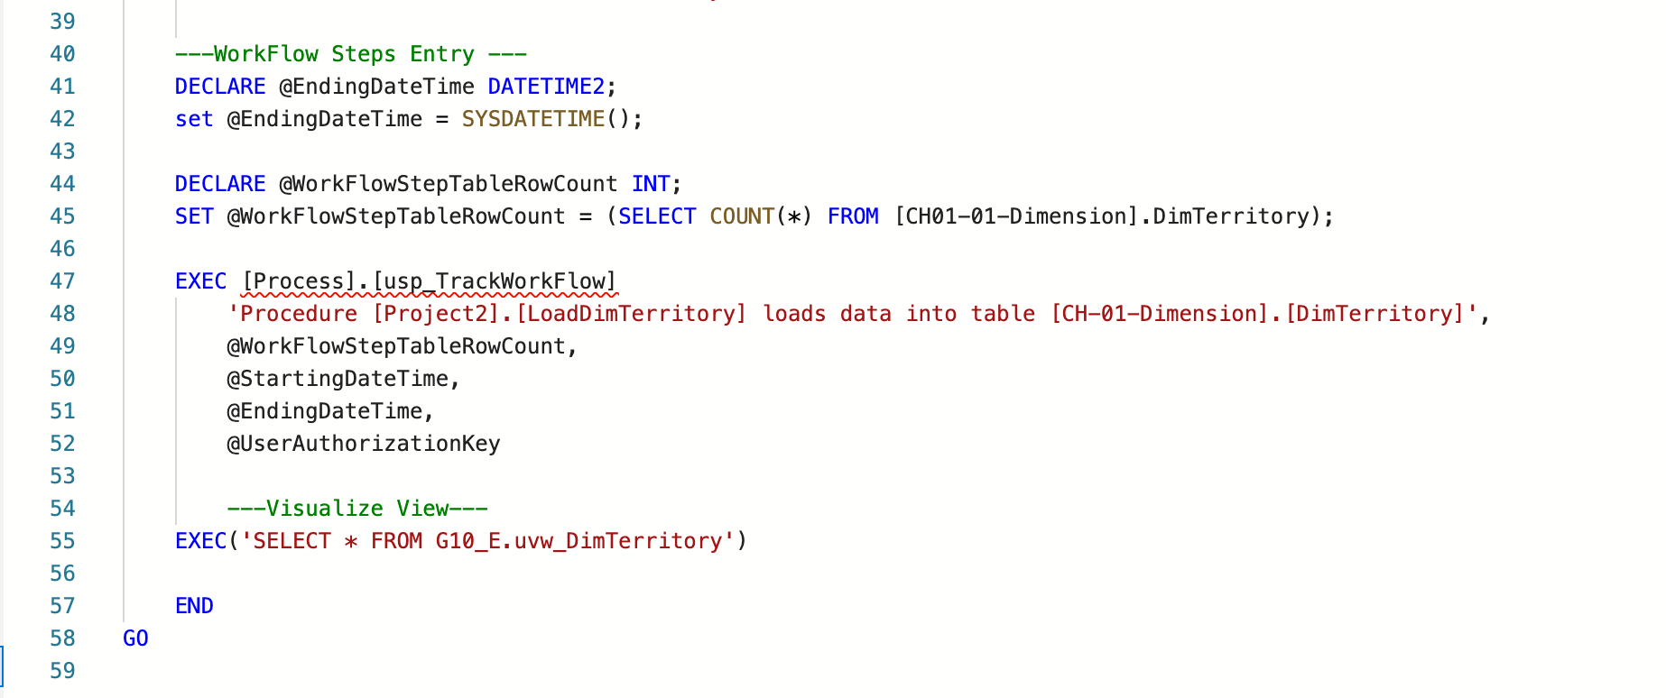
Load_DimTerritory
Populates the DimTerritory table
Inserts Data into [CH01-01-Dimension].[Dim.Territory]
Returns only distinct values of territory

Slide 10
Carlos’ Stored Procedures
1) Load_DimMartialStatus
2) Load_DimOccupation
3) Load_DimOrderDate

Slide 11
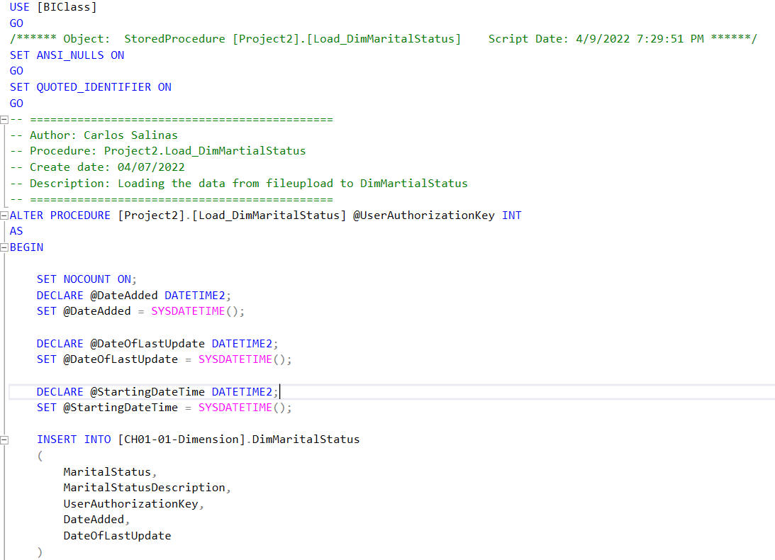
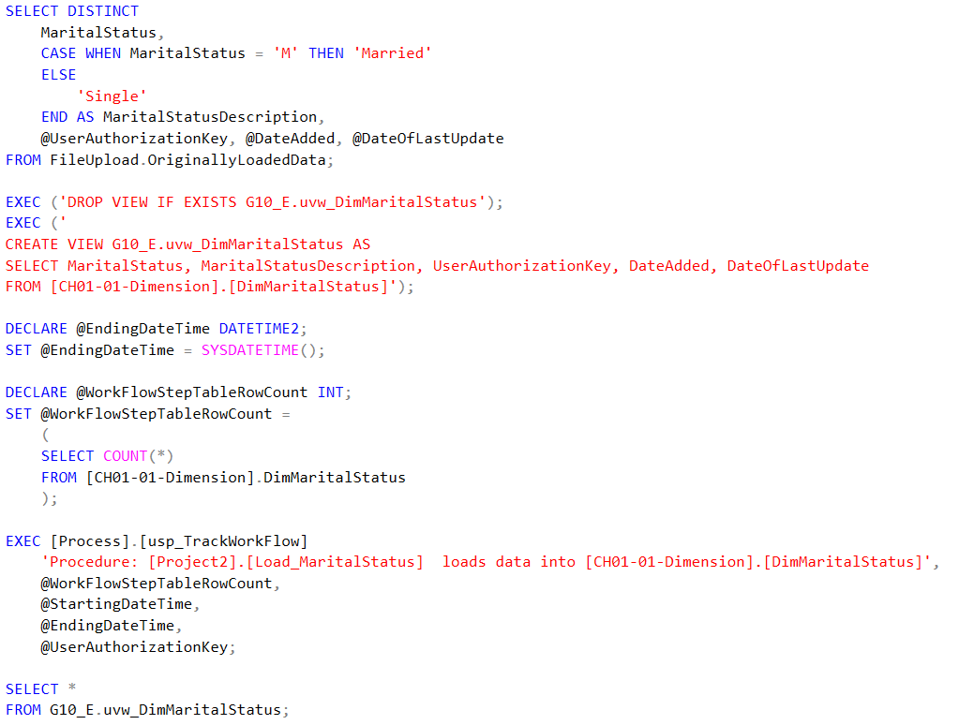
Load_DimMartialStatus

Slide 12
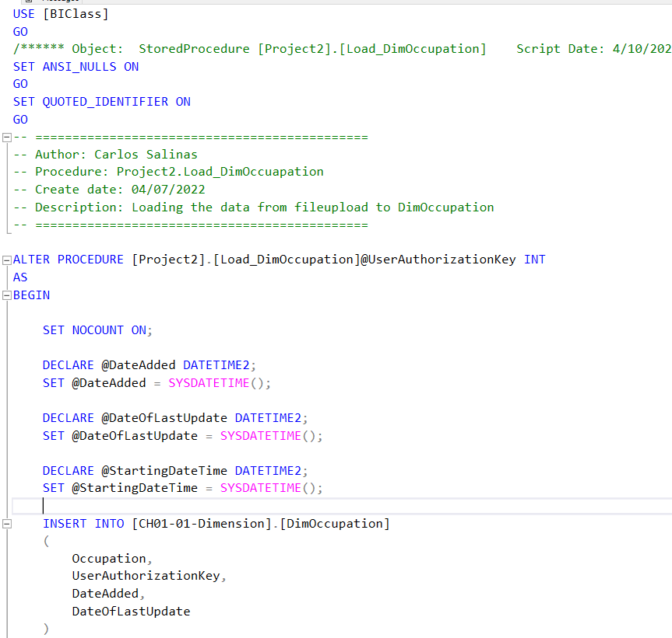
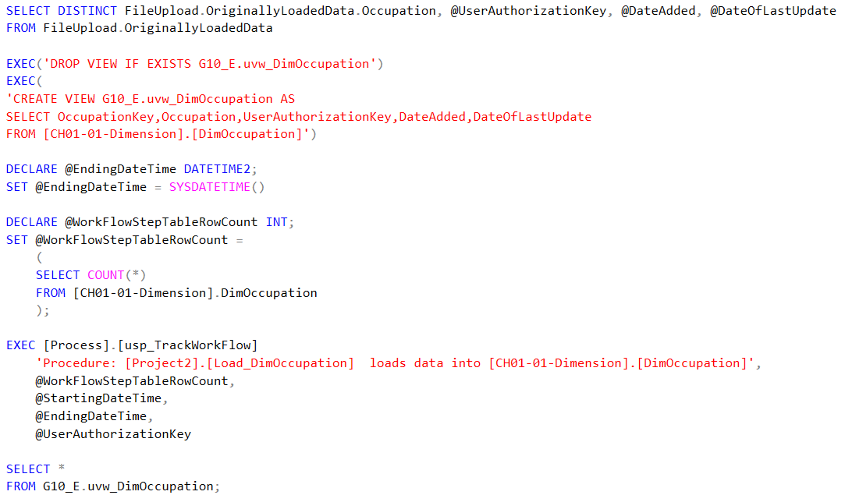
Load_DimOccupation

Slide 13
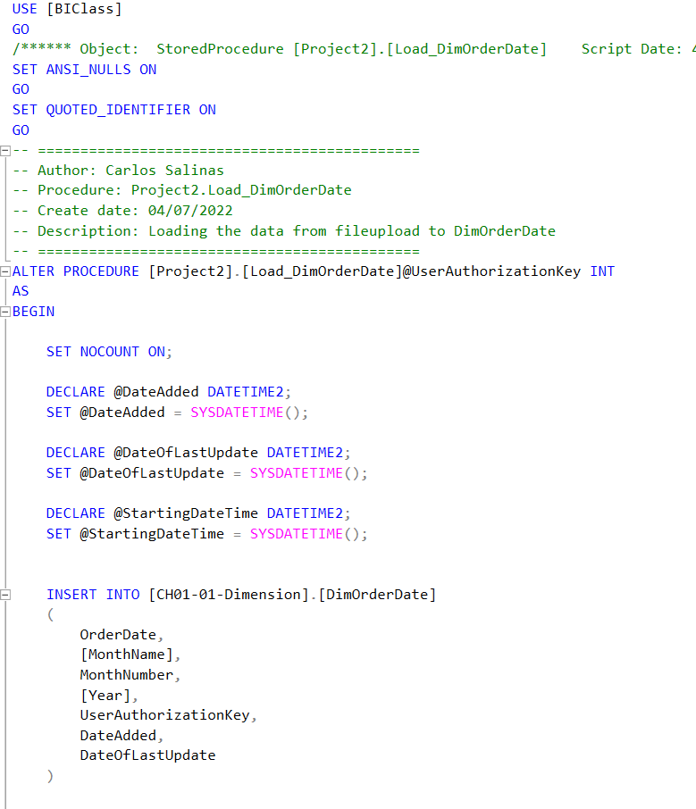
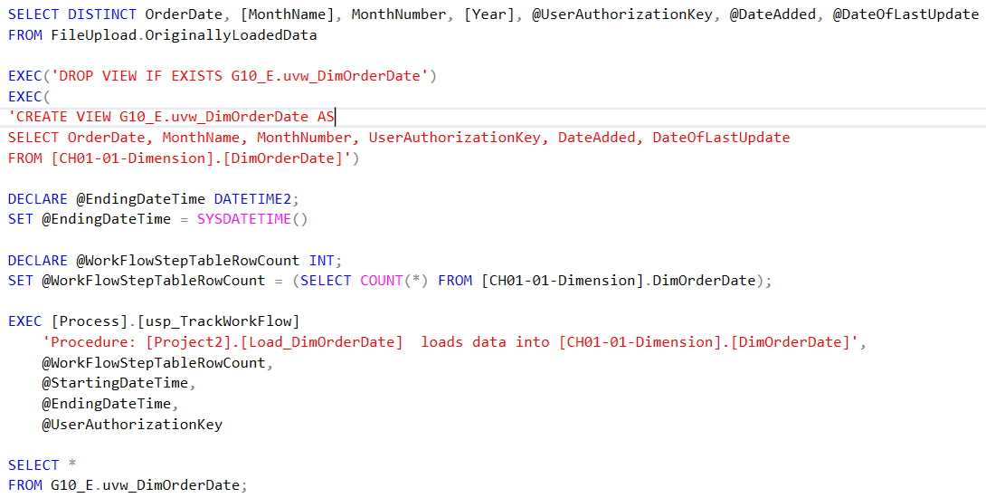
Load_DimOrderDate

Slide 14
Jay’s Stored Procedures
Load_DimProductCategory
Load_DimProductSubCategory
Load_DimProduct
The tables will be related to the product table using the grandparent to parent to child relationship below:
1. [CH01-01-Dimension].[DimProductCategory]
a. [CH01-01-Dimension].[DimProductSubcategory]
i. [CH01-01-Dimension].[DimProduct]

Slide 15
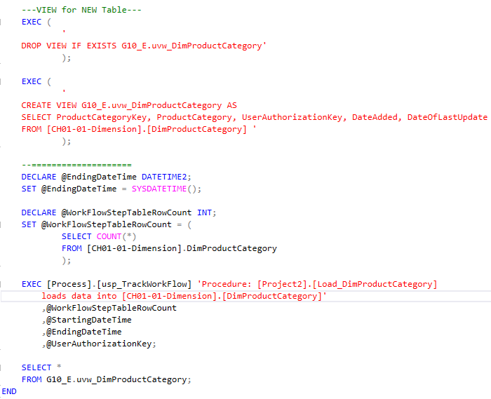
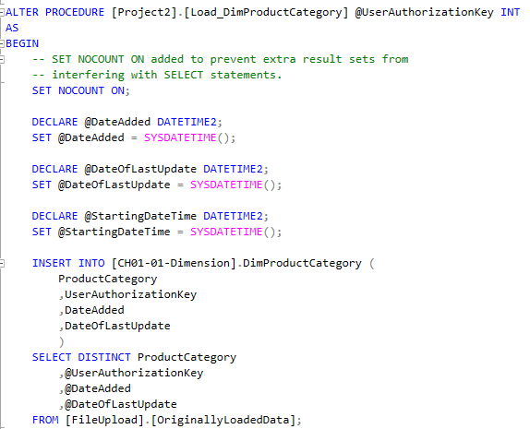
Load_DimProductCategory

Slide 16
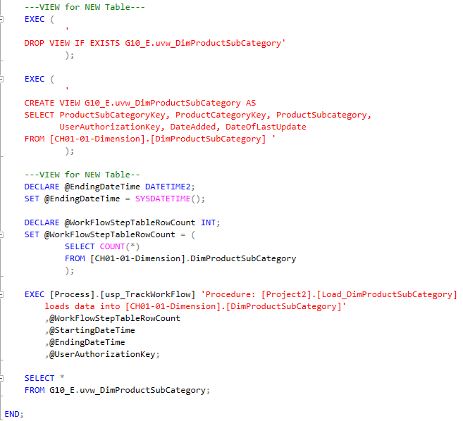
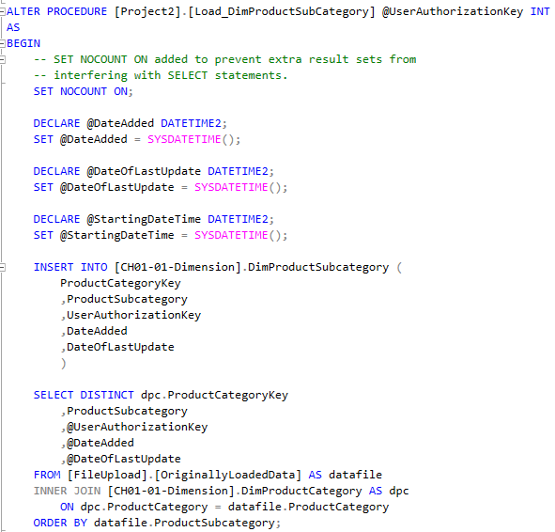
Load_DimProductSubCategory

Slide 17
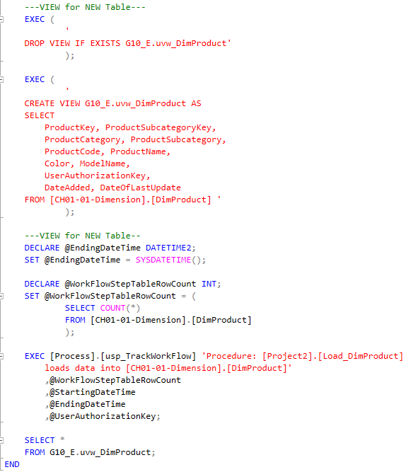
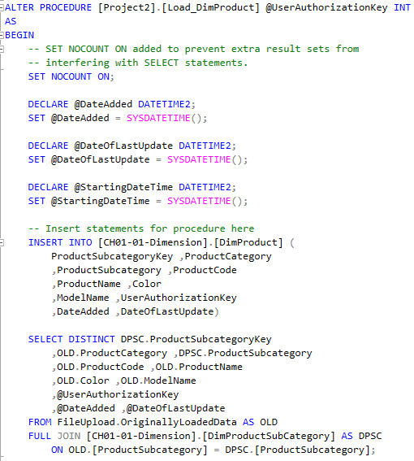
Load_DimProduct

Slide 18
Bing’s Stored Procedures
Load_SalesManagers
ShowTableStatusRowCount
TruncateStarSchemaData

Slide 19
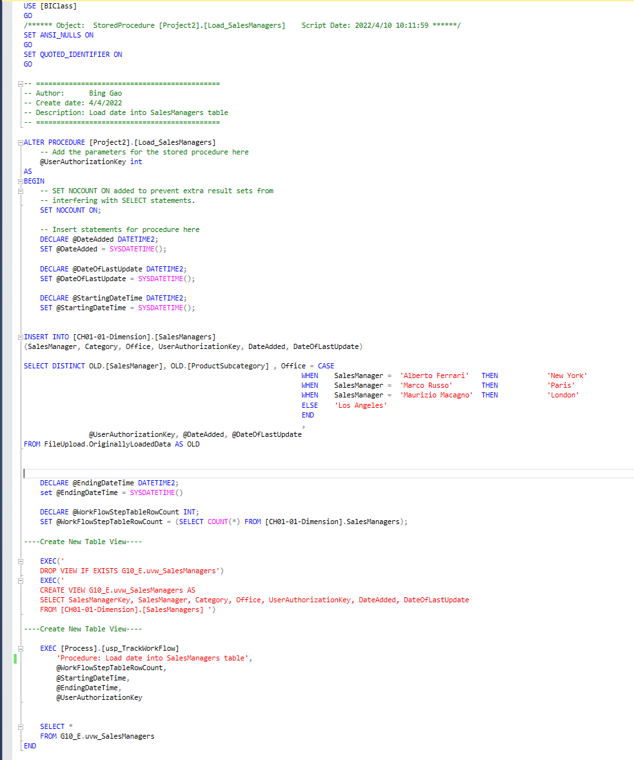
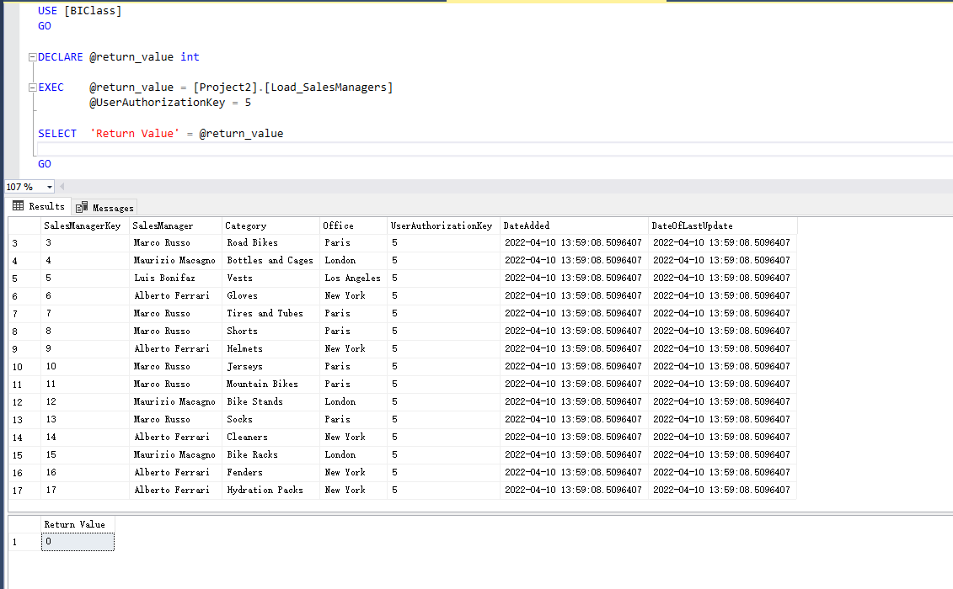
Procedure Load_SalesManagers
Insert data from FileUpload.OriginallyLoadedData
Create a view to query the results
Save the runtime into TrackWorkFlow

Slide 20
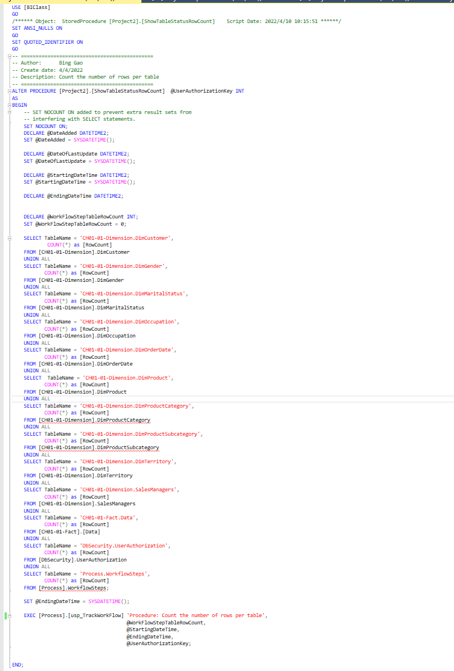
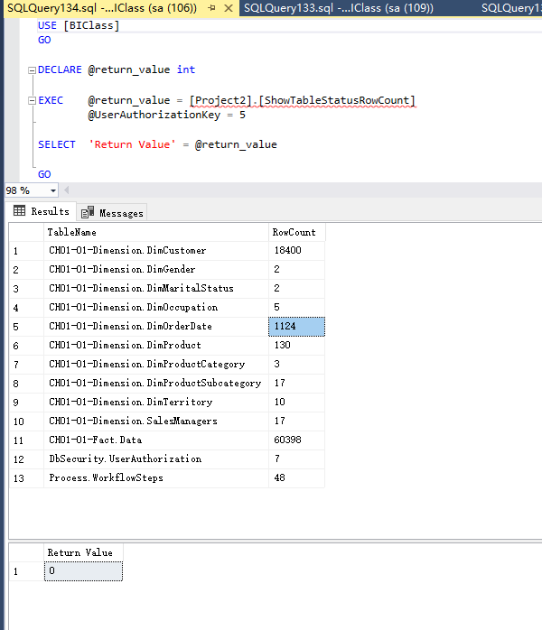
Procedure ShowTableStatusRowCount
Display row count for all tables
Save the runtime into TrackWorkFlow

Slide 21
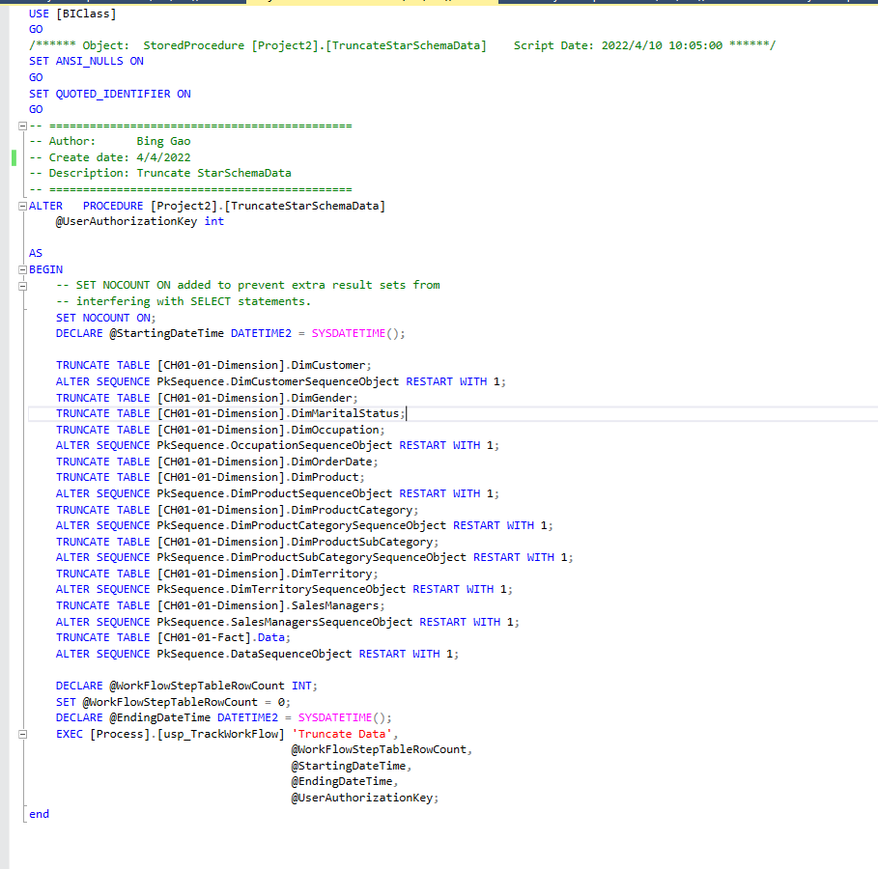
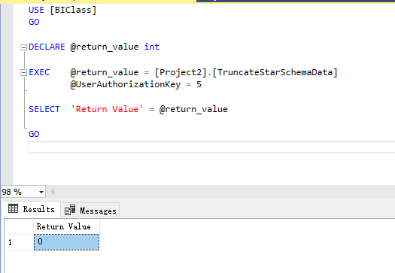
Procedure TruncateStarSchemaData
Truncate the data for all tables
Reset the PKsequence to 1
Save the runtime into TrackWorkFlow

Slide 22
Edwin’s Stored Procedures
LoadStarSchema
TrackWorkflowSteps
ShowWorkflowSteps

Slide 23
LoadStarSchema
This stored procedure is in charge of loading all the procedures in order.
First it drops the foreign keys, with a ready made procedure
Second, it truncates the tables so no duplicate data is found
Then it loads all procedures that fill tables with data.
After that, it adds back foreign keys with another ready made procedure
Finally, it adds a new entry into the workflow steps to be tracked.

Slide 24
TrackWorkflowSteps
This is a procedure that is supposed to be ran after every procedure is completed to keep track of which user id was behind the procedure.
The Procedure is relatively in use functionality, all it really does is insert a new row into a table called Process.WorkflowSteps
Some of the values that are stored in this table are Workflow Description, start and end time for tracking purposes, and a user authorization id.

Slide 25
ShowWorkflowSteps
This is perhaps the most simplest procedure of them all.
All it really does is a run a Select for all the columns on all the entries in the process.WorkflowSteps table

Slide 26
Thank You

